Slide 1
Abstract Communication Layer
TCP-IP Solution (Open Source)
Olivier Van Nieuwenhuyze
V1.0
March 22nd, 2019

Slide 2
Agenda Slide
1
Project Introduction
2
Overview
3
Tools used
4
APIs
5
Architecture Description
6
Next Steps

Slide 3
GlobalPlatform IPR Version v5.0
“Please be aware that this meeting is being held under the GlobalPlatform Intellectual Property Rights Policy. If you do not have a copy of this policy, please contact (or inform) the chairperson during this meeting. You may also view and download a copy of the policy at the Membership section of the GlobalPlatform Website.
At this time, each person in attendance is required to inform the chairperson if they are personally aware of any claims under any patent applications or issued patents which would be likely to be infringed by an implementation of any specification or other work product which is the subject of this meeting. You need not be the inventor of such patent or patent application in order to inform GlobalPlatform of its existence, nor will you be held responsible for expressing a good faith belief which proves to be inaccurate.”
Effective on 15 March 2014 – IPR v5.0 can now be found on the Member website: Resources > Documents https://members.globalplatform.org/apps/org/workgroup/resources/download.php/6785/latest

Slide 4
Secure Element IP Connector Activity
Open Source Project approved by the Board
Effective Date : February 11th, 2019
Git Hub project created
Administrator : Olivier Van Nieuwenhuyze
Link GP : https://members.globalplatform.org/kws/specifications/open-source/
Link Git Hub : https://github.com/GlobalPlatform/SE-test-IP-connector
Charter : https://members.globalplatform.org/kws/specifications/open-source/Charter_and_Rules_for_the_SE_IP_connector_02112019.docx

Slide 5
TCP/IP
Test Tool
ADMIN_CORE_
INTERFACE
Server
Client
Custom Layer
Specific HW
ADMIN_OTA_
INTERFACE
ADMIN_CL_
INTERFACE
Contactless Reader
TOE
CONTACTLESS_
INTERFACE
In this example, the target has
a unique abstract communication layer for ADMIN CORE, ADMIN OTA and ADMIN CL interface
No SWP, but it may be accessed directly by a standard contactless reader (real ISO14443 interface)
Abstraction Communication Layer and Specific HW + adapted board are provided by the Target Supplier
Test tool shall create
A link to the TCP_IP Server to access to the TOE (and aggregate the ADMIN CORE, ADMIN OTA, ADMIN CL interface)
one connection to its own Contactless reader (for the Contactless Interface)

Slide 6
TCP/IP
Test Tool
ADMIN_CORE_
INTERFACE
Server
Client
Custom Layer
Specific HW
ADMIN_OTA_
INTERFACE
ADMIN_CL_
INTERFACE
Contactless Reader
TOE
CONTACTLESS_
INTERFACE
Open source
Provided by TOE requester

Slide 7
TCP/IP Cont.
Test Tool
ADMIN_CORE_
INTERFACE
Server
Client
Custom Layer
Specific HW
ADMIN_OTA_
INTERFACE
ADMIN_CL_
INTERFACE
Client
Custom Layer
Specific HW
TOE
CONTACTLESS_
INTERFACE

Slide 8
TCP/IP Cont.
Test Tool
ADMIN_CORE_
INTERFACE
Server
Client
Custom Layer
Specific HW
ADMIN_OTA_
INTERFACE
ADMIN_CL_
INTERFACE
Client
Custom Layer
Specific HW
TOE
CONTACTLESS_
INTERFACE
Client
Custom Layer
Specific HW

Slide 9
Architecture
GUI
Executable
Test Tool
API
Server
Client
Class
Custom Layer
TCP/IP
Executable
Dll
Dll

Slide 10
Tools Used
Eclipse C 2019-03–RC1 (4.11 RC1) (Freeware)
C/C++ language (For DLL)
Additional modules for Eclipse
MinGW-w64 (Minimalist GNU for Windows)
Includes a port of GCC, GNU Binutils for Windows (assembler, linker, archive manager) and freely distributable set of header files and static import libraries (enable the use of Windows API)
Library Nlohmann JSON (https://github.com/nlohmann/json)
Library Plog (https://github.com/SergiusTheBest/plog)
Visual Studio Community (15.9)
C# language for Exe
Windows Presentation Foundation (WPF) for the graphical user interface

Slide 11
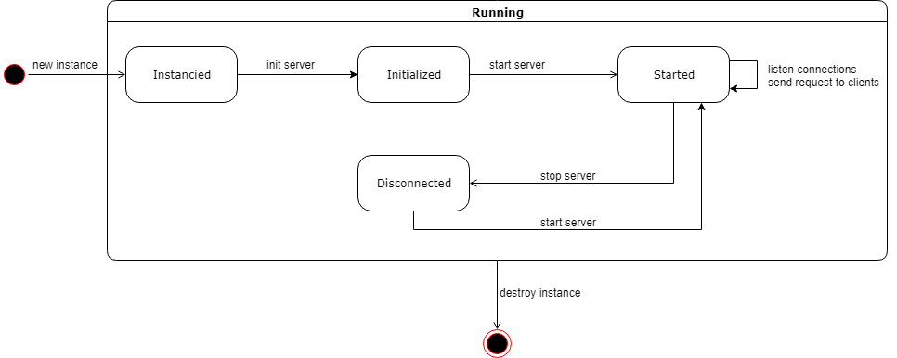
Server API Format – Startup & disconnection
InitServer → Initialize the server with the given configuration file (JSON Format)
StartServer → Start the server, it is now able to listen for requests and listening/accepting incoming connections (on a separate thread) from clients
StopServer → Shutdown the server and its clients

Slide 12
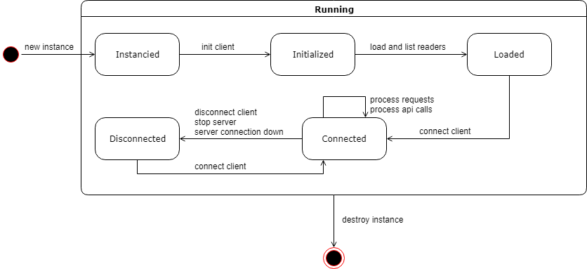
Client API Format – Startup & disconnection
InitClient → Initialize the client with the given configuration file (JSON Format)
LoadAndListReaders → Load connected readers
ConnectClient → Connect to the server and with the given reader
DisconnectClient → Disconnect the client from the server and disconnect the reader

Slide 13
Server API Format – Callbacks
SetCallbackConnectionAccepted → Callback meant to be called whenever the server accept a connection with a client

Slide 14
Server API Format – Administration
ListClients → Return a list containing data about connected clients
EchoClient → Return a packet used to verify whether a client is still alive
DiagClient → Return a diagnostic about a client and its underlying layers
RestartClient → Restart the client's target
StopClient → Stop a client

Slide 15
Server API Format – Communication
SendCommand → Send an APDU command to a client and return its response
ColdReset -> Perform power OFF, power ON and return ATR
WarmReset -> Perform reset without power switch and return ATR
PowerONField -> Set the field ON
PowerOFFField -> Set the field OFF
SendTypeA -> Send an APDU command over RF Type A
SendTypeB -> Send an APDU command over RF Type B

Slide 16
Client API Format – Callbacks
SetCallbackConnectionLost → Callback meant to be called whenever the connection with the server is lost
SetCallbackRequestsReceived → Callback meant to be called whenever a request is received from the server
SetCallbackResponseSent → Callback meant to be called whenever a response is sent to the server

Slide 17
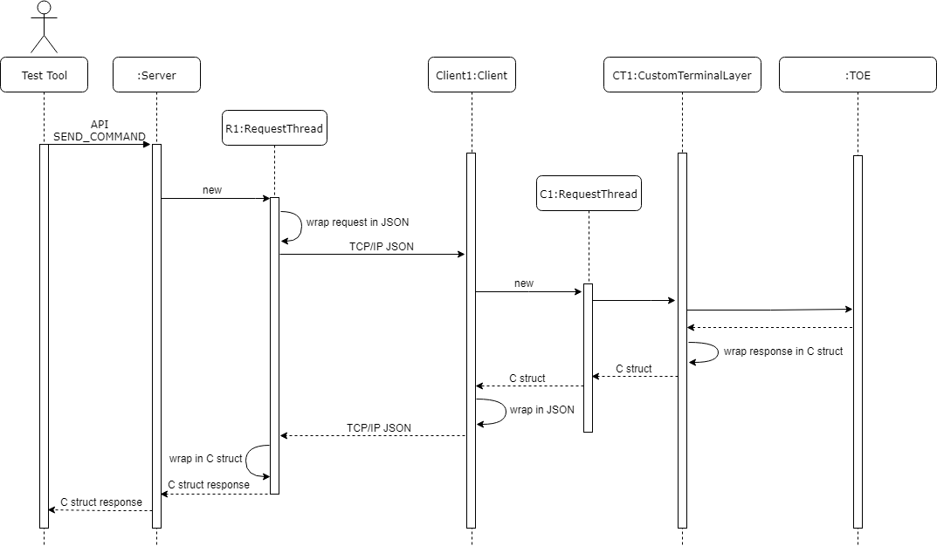
Multi-Threaded Arch. (Send Cmd – No Error)

Slide 18
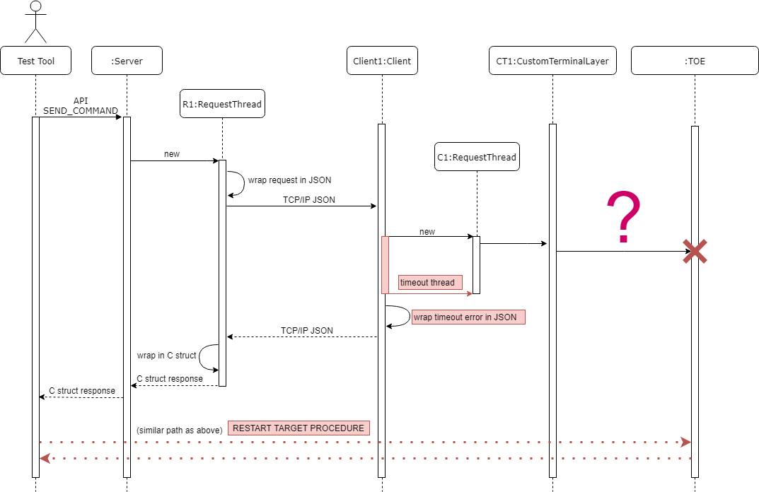
Multi-Threaded Arch. (Send Cmd – TOE not responding)

Slide 19
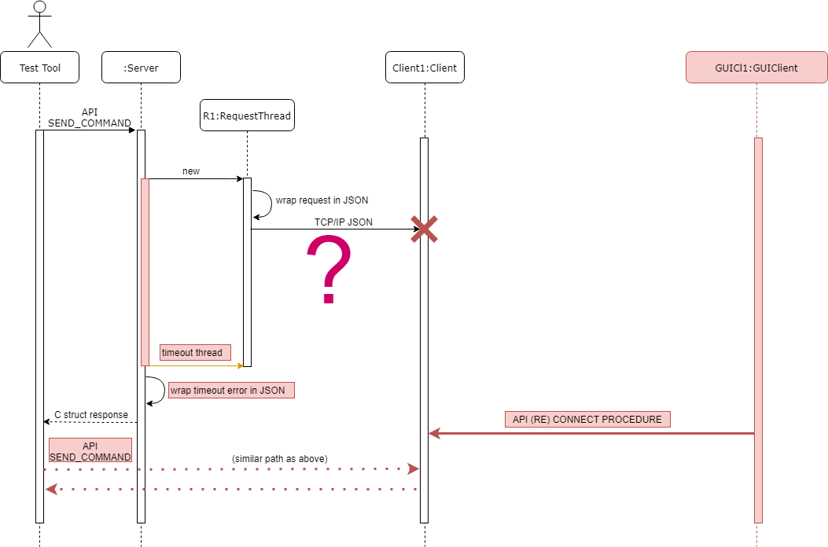
Multi-Threaded Arch. (Send Cmd – Client not responding)

Slide 20
Client – Server Communication
Server
Client
JSON Structure
The JSON Structure used to request the client contains
A request code used to identify which request the client has to process
The data (optional) supplementing the request (e.g. the APDU for a command request)
A timeout which correspond to the tolerated waiting time by the server before responding to the request
The JSON Structure used to respond to the server contains
A response corresponding to the processed request
An error code for each layer (server, client, terminal and card) which is 0 when everything is fine
An error description for each layer (server, client, terminal and card) which is “OK” when everything is fine

Slide 21
Errors handling
C Struct used to hold the response and errors related information
One field for the response
One field for each layer (Server, Client, Custom, Card) indicating the error code (value 0 means no error)
One field for each layer indicating the error description (value “ok” means no error)
Error hierarchy
Each layer is responsible of setting its own errors code/description (e.g. client not found, card not connected, etc…)
Server > Client > Custom Layer > Card
Response | Err code server | Err description server | Err code client | Err description client | Err code custom layer | Err description custom layer | Err code card | Err description card
KO | 0 | OK | -2 | Response time from terminal has elapsed | OK | 0 | OK | 0

Slide 22
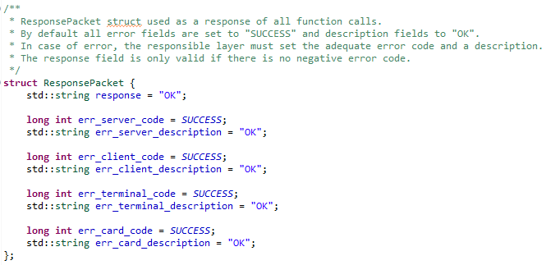
Errors handling

Slide 23
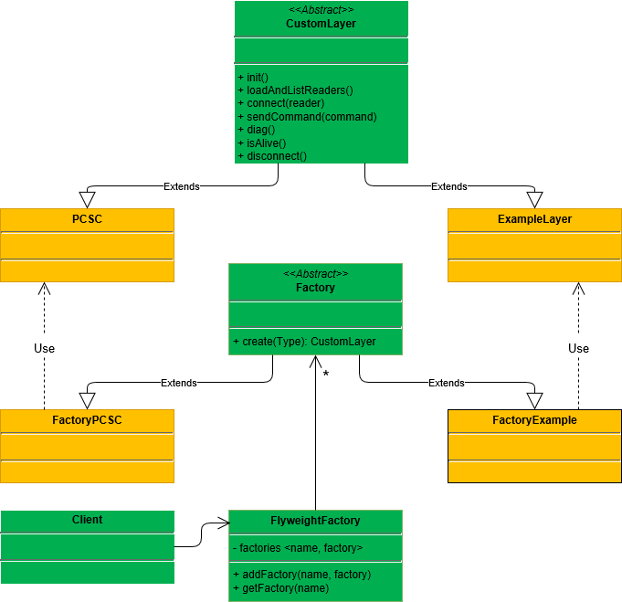
Custom Layer
Steps to implement a new custom layer
Implement a derived class of the abstract class CustomLayer
Implement a derived class of the abstract class Factory returning an instance of CustomLayer
Insert the implemented factory into the FlyweightFactory alongside its name (e.g. PCSC, ideally its class name)
Retrieve the desired CustomLayer implementation in the Client

Slide 24
Next Steps
First push next week
Limitation
Callback limited
All API not yet implemented (RF part)
…
Questions: what do you want to see pushed to Github ?
Only .c .cpp and .h files ?
All Eclipse project including settings for the linker and the compiler ?
… ?

Slide 25

Thank you
Subtitle goes here

